Slide 1
Factors influencing the database selection for B2C web applications.
Master Thesis Final Presentation
Al-Saeedi, Bilal | 18.04.2016
Notes:
Supervisor : Manoj
CoSupervisor: Andreas Kipf from database chair

Slide 2
Agenda
Motivation
Objectives
Analysis
Results
Evaluation
Live Demo
Conclusion & Future Work

Slide 3

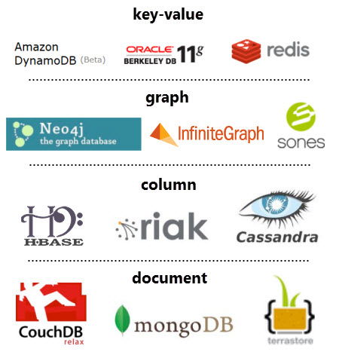
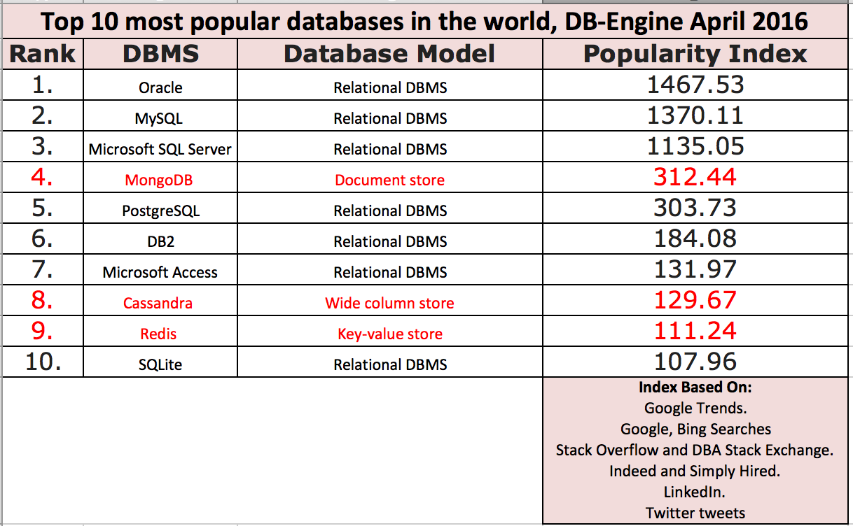

Motivation
Many options
Interest growth
© sebis
3
Notes:
NoSQL database came lately to solve problems related to performance, scalability, availability.
Growth interest in them as seen in the graph (top popular database)
However, there are many of them
Different categories, data, query models, solve different problems
Confusing decision ,RDBSM was easy (few to choose from)
Bad decision can have serious consequences
====== backup ===
For any application, a good database needs to be chosen to store, retrieve and analysis our data.
Selecting the database system is important and we might impact the whole application if we made wrong selection.
Previously there was only the RDBMS solutions and it was even then a difficult decision for the system architect and software designer.
Now after NOSQL emerged to offer high performance (both in terms of speed and size) and high availability and now we have over 120 such solutions.
it is even more confusing decision to make.
After this Thesis, we hope we can provide some guidelines and tips and some influencing factors that can help users to know if the are selecting the right database or not.

Slide 4
Objectives
Analyze Chosen Constructs
Test Data Modeling
Test Query Options
Analysis Results
Strengths, Weaknesses, Suitable Scenarios
Identify Influencing Factors
Assist architects, developers and IT managers to adopt the right NoSQL solution
Theoretical
Experimental
© sebis
3
Notes:
To analyse and compare a set of chosen constructs for each of the investigated
databases.
To explore the data modelling capabilities of each database by modeling a real
data model taken from the B2C application domain.
To study the query capabilities of each database by writing complex queries
that reflect the activities of a real B2C application.
To determine the strengths, weaknesses, and the suitable use cases for each of
the investigated databases based on the results of the comparison.
To identify the most important factors influencing the adoption of a NoSQL
solution.

Slide 5
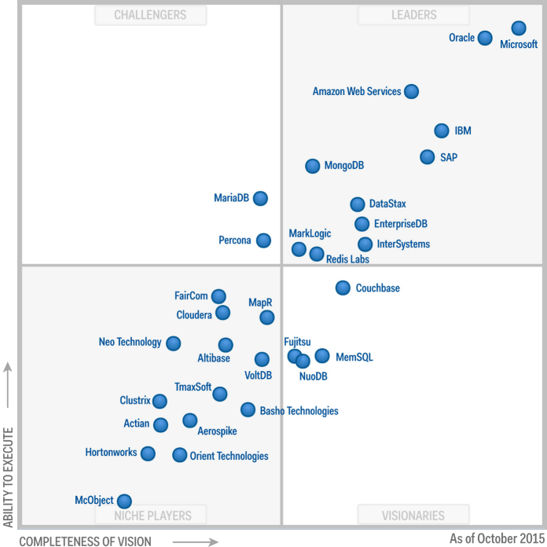



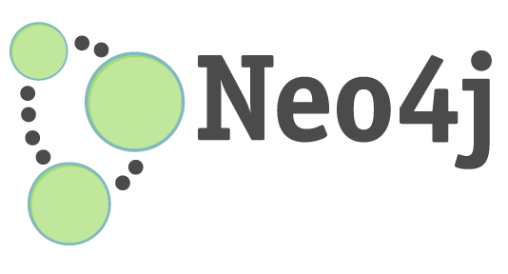
Analysis – Databases
Key-Value
Document-Based
Wide-Column
Graph-Based
Gartner Magic Quadrant for Operational DBMS 2015
© sebis
3

Slide 6
Analysis – Chosen Constructs
Basics
Underlying Structure
Quality Attributes
Scalability
Query Model
Use Cases
Text Search Support
Transaction Support
Data Import and Export
Data Layout
Data Model
Query Language
Relational Data Support
Aggregation and Filtering
Indexing
Sorting
Query Option
Persistency
Security
Availability
© sebis
3

Slide 7
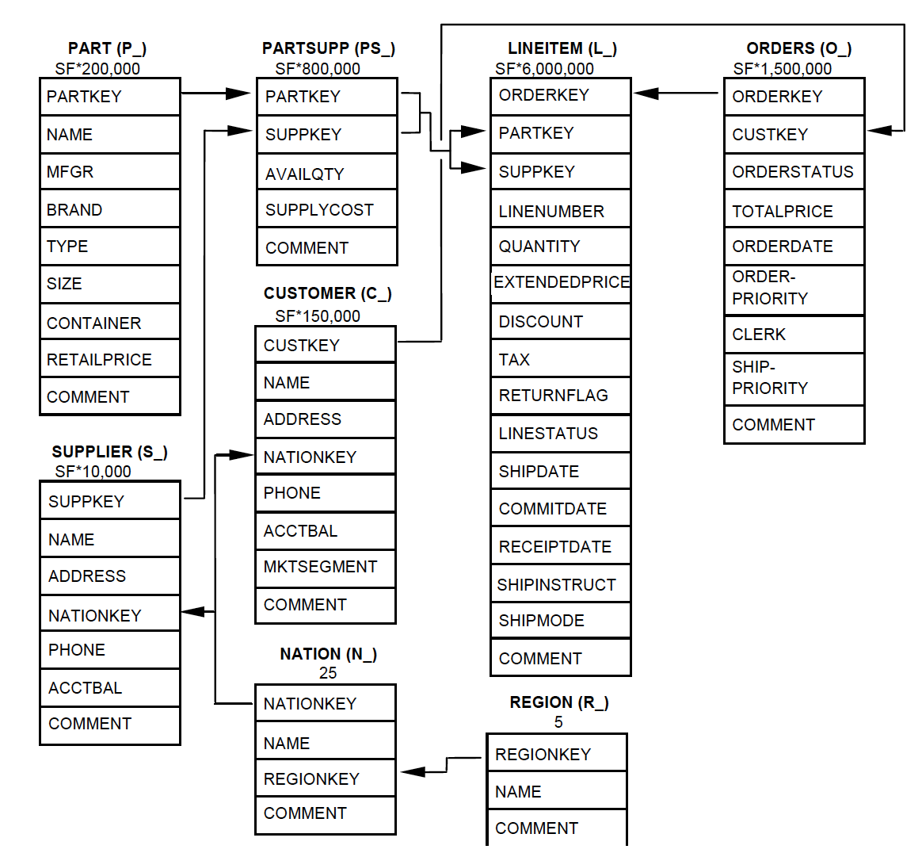
Analysis – Chosen Data Model
TPC-H Data Model
© sebis
3

Slide 8
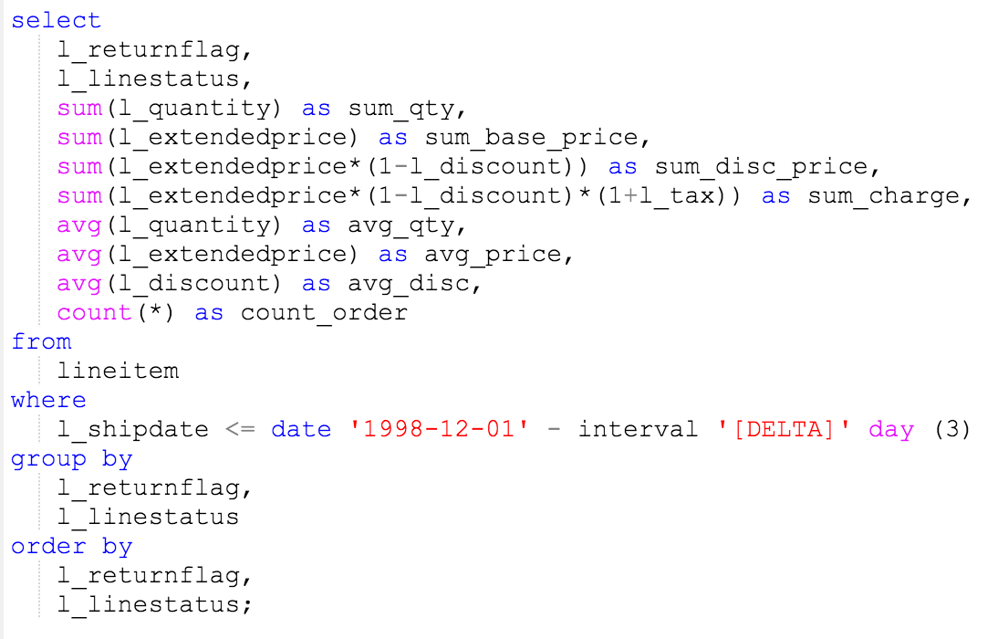
Analysis – Chosen Queries
Pricing Summary Report Query (Q1)
© sebis
3
Notes:
Why only three queries
Note about the query

Slide 9
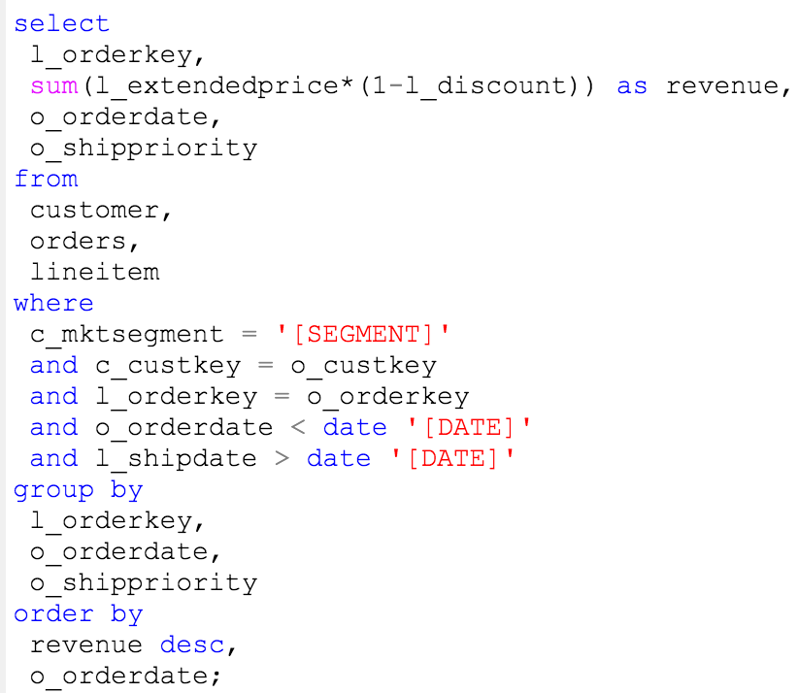
Analysis – Chosen Queries
Shipping Priority Query (Q3)
© sebis
3
Notes:
Note about the query

Slide 10
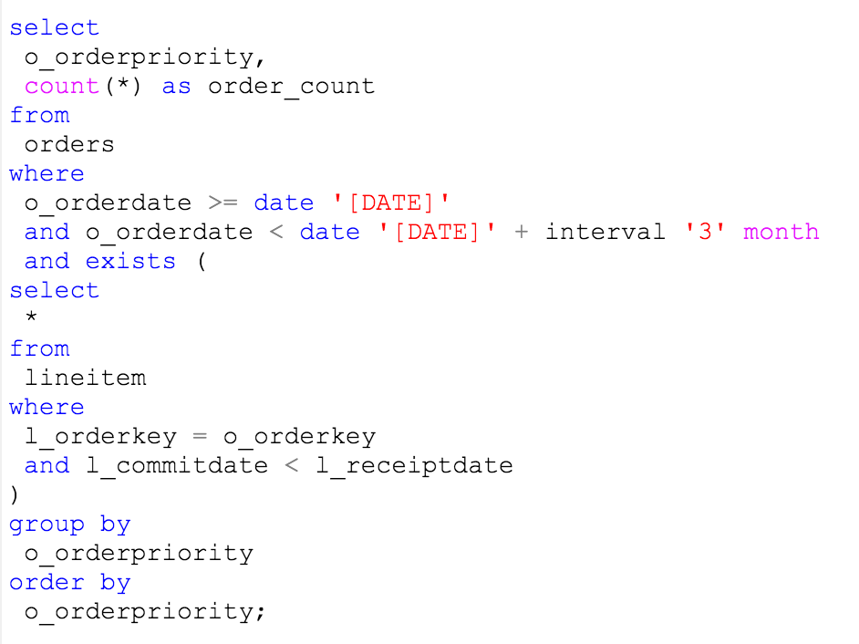
Analysis – Chosen Queries
Order Priority Checking Query (Q4)
© sebis
3
Notes:
Note about the query

Slide 11
Analysis – Synthesis
TPC-H Queries
TPC-H Data Model
Java Implementation
Results

Slide 12
Results –Basics Comparison
 | Redis | MongoDB | Cassandra | Neo4j
Underlying Structure | Strings, lists, hashes, sets and sorted sets. | BSON documents inside collections. | Ordered columns with a primary row key. CQL tables. KeySpace. | Nodes and relationships. Labels. Relationships Type.
Query Language | Set of commands. | CRUD operations at collection level. | SQL-like query language called CQL. | Declarative query language called Cypher.
© sebis
3

Slide 13
Results - Data Model Comparison
 | Redis | MongoDB | Cassandra | Neo4j
Data Layout | No schema design upfront. Choose data types to represent the data. | Schema-less. Doesn't enforce documents structure. Data modeling is more flexible. Normalized model by using references. Denormalized model by embedding documents. | Data model around the query patterns. Data redundancy is acceptable. | Convert data into nodes and relationships to build graph model. Identify node labels and relationship types. Data stored as node properties. Relationship related data stored as relationship properties.
Relational Data Support | Modeling deeply connected data isn't recommended. Relations can be modeled using sets and sorted sets. | Denormalized approach for one-to-one relationship. Normalized/Denormalized approaches for one-to-many relationship depending on the document size growth. Normalized approach for many-to-many relationship. | No joins. Relationships are modeled by creating a table for each relationship query. | All relationships are represented in the same way through one relationship.
© sebis
3

Slide 14
Results - Data Modeling Testing Result
- Difficult to model a complex data model such as the TPC-H model.
- Expected since it isn’t designed for that.
- Small version of the TPC-H model was used.
- Data model is around the queries.
- Three tables for the three TPC-H queries.
- Simply converted to nodes and relationships.
- Data stored as properties.
- Labels for table names.
- Relationship types for each relationship.
- Flexible modeling, many possibilities.
- Denormalized approach used.
- One document embedding all other entities.
© sebis
3

Slide 15
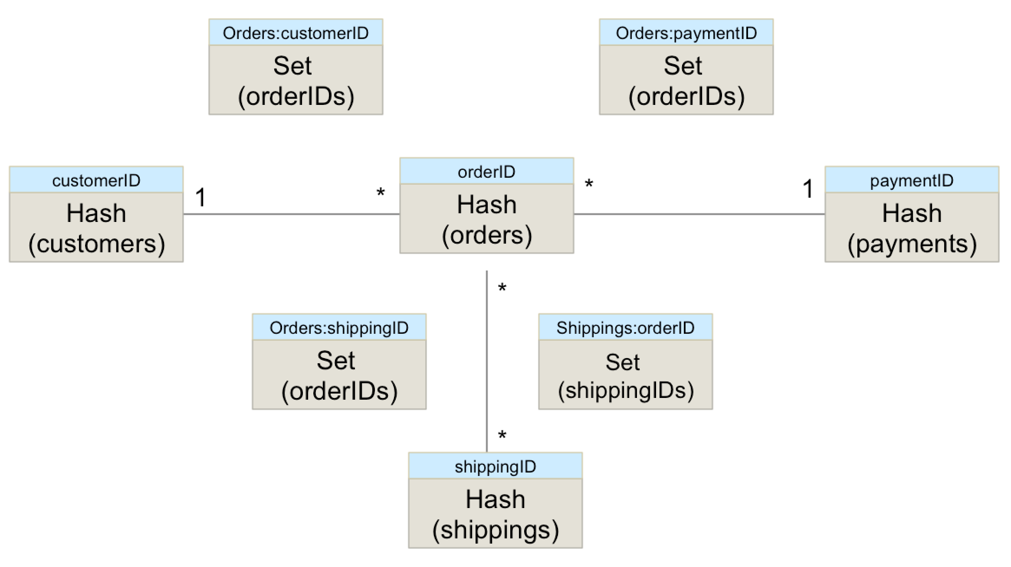
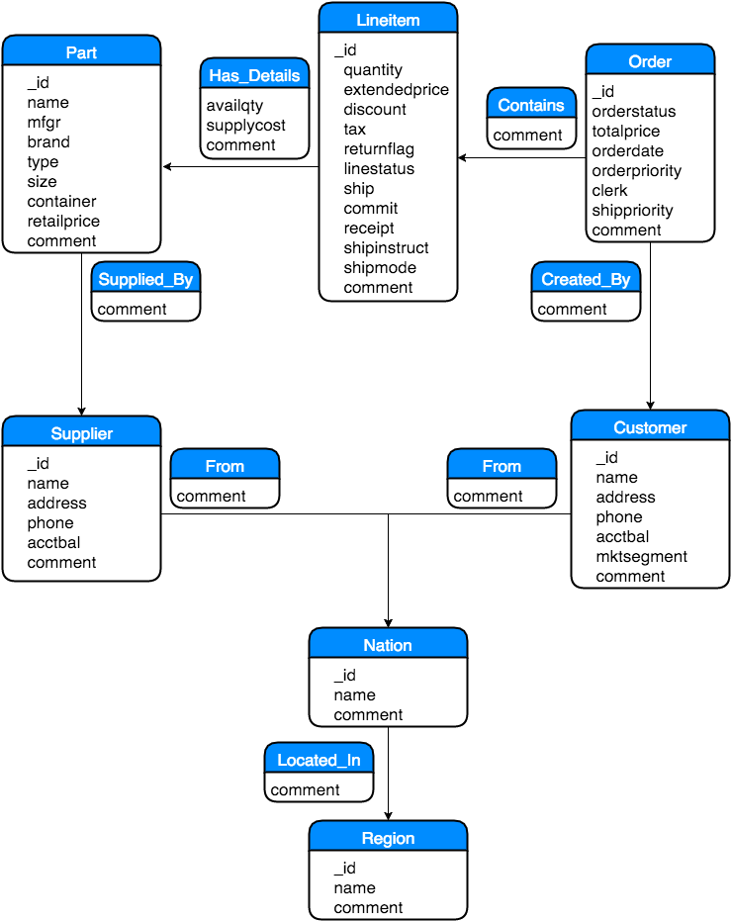
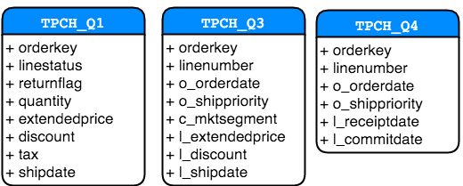
Results - Data Modeling Testing Result

Slide 16
Results - Query Model Quick Comparison
 | Redis | MongoDB | Cassandra | Neo4j
Aggregation | No aggregation support. | Aggregation supported using the aggregation pipeline framework or a map reduce. | Aggregation functions supported. Aggregation at the partition level. | Aggregation supported. Many aggregation functions.
Indexing | The key is the primary index. No secondary indexes support. | Many index types are supported. Defined on the collection level. | Secondary index supported. | Secondary index support.
Sorting | A Sort command is supported. | A sort method is supported. | Sorting supported using the clustering columns. Clustering columns defined during the table creation. Using CQL ORDER BY clause with the ASC or DESC options. | ORDER BY clause to sort the results.
© sebis
3

Slide 17
Results - Query Options Testing Result
- Challenging to write queries on relational model.
- Client-Side code complexity.
- Manually handling joins.
- Expected since it isn’t meant for complex queries.
- Many follow-up queries for relationships.
- Easy to write queries (SQL-similar syntax).
- Query, Aggregation, and sorting limitations.
- Not possible to achieve the same requirements as the TPC-H queries.
- Straightforward to write the TPC-H queries using Cypher.
- Equivalent Cypher queries are shorter (group-by Clause not required)
- No date support.
- The same requirements of the TPC-H queries were achieved.
- Difficult and time-consuming. Very big equivalent queries.
-Aggregation and queries are executed at the collection level.
- Was possible to achieve the same requirements as the TPC-H queries.
© sebis
3
Notes:
Redis:
- Difficult to model relational data.
- Query and aggregation limitations.
- No support for secondary indexes.
Mongo:
- Queries written using the pipeline aggregation framework.
- Query divided into multiple stages.
- Data should fit the document data model.

Slide 18
Results - Query Options Testing Result
[
{
"$match":{
"Customer.MKTSEGMENT":"AUTOMOBILE",
"ORDERDATE":{
"$lte": ISODate("2000-01-01T00:00:00.000Z")
},
"Items.SHIPDATE":{
"$gte": ISODate("1990-01-01T00:00:00.000Z")
}
}
},
{
"$unwind":"$Items"
},
{
"$project":{
"ORDERDATE":1,
"SHIPPRIORITY":1,
"Items.EXTENDEDPRICE":1,
"l_dis_min_1":{
"$subtract":[
1,
"$Items.DISCOUNT"
]
}
}
},
{
"$group":{
"_id":{
"ORDERKEY":"$ORDERKEY",
"ORDERDATE":"$ORDERDATE",
"SHIPPRIORITY":"$SHIPPRIORITY"
},
"revenue":{
"$sum":{
"$multiply":[
"$Items.EXTENDEDPRICE",
"$l_dis_min_1"
]
}
}
}
},
{
"$sort":{
"revenue":1,
"ORDERDATE":1
}
}
]
SELECT
orderkey,
sum(CASSANDRA_EXAMPLE_KEYSPACE.fSumDiscPrice(l_extendedprice,l_discount)) as revenue,
o_orderdate,
l_shipdate,
o_shippriority,
linenumber
from
CASSANDRA_EXAMPLE_KEYSPACE.TPCH_Q3
where
orderkey= 'somekey'
and o_orderdate = 'somedate'
and o_shippriority='somepriority'
and c_mktsegment='Segement'
and l_shipdate > '1990-01-01';
MATCH
(item:Lineitem) <-[:CONTAINS]- (order:Order ) -[:CREATED_BY]-> (customer:Customer)
WHERE order.ORDERDATE < 912524220000
AND item.SHIPDATE > 631205820000
AND customer.MKTSEGMENT = 'AUTOMOBILE'
RETURN order.ORDERKEY,
sum(item.EXTENDEDPRICE*(1-item.DISCOUNT)) AS REVENUE,
order.ORDERDATE,
order.SHIPPRIORITY
ORDER BY REVENUE DESC, order.ORDERDATE
Notes:
Shipping Priority Query (Q3)
Cassandra:
Not possible to group by and order by the same field (order date)
Not able to sort by a field that was returned by the query
Aggregation only partition-wise not across all partitions
Neo4j:
No date support, use Unix time as long value instead
MongoDB:
Time consuming
Big Queries.
On collection level

Slide 19
Results - Quality Attributes Comparison
 | Redis | MongoDB | Cassandra | Neo4j
Scalability | Scaling reads using replications. Scaling writes using sharding. Auto-sharding and balancing using Redis cluster. | Scaling using the Sharded Cluster. Auto-sharding and balancing. | All nodes accept read/write requests. Scaling by adding and removing nodes. Auto-partitioning based on partition key. | Scale reads using the HA master-slave clusters. Only vertical scaling the write load. No support for sharding.
Persistency | Using Snapshoting and AOF. | Two persistent storage engines. Journalling for more durable solution in the event of failure. | Fully durable. Data is written directly to a commit log. | Fully durable. Once transactions is committed, it will be written directly to disk.
© sebis
3

Slide 20
Evaluation - NoSQL Adoption Influencing Factors
Data Related Factors
Data Complexity
Data Access Patterns
Query Related Factors
Text Search Support
Quality Attributes Related Factors
Performance
Schema Flexibility Requirement
Indexing
Aggregation
Ad-Hoc Queries Support
Range queries
Joins Support
Scalability
Availability
Durability
Transaction support
Security
Database Simplicity
Other factors
Other Factors
License Type
Community & Documentation Strength
Maturity
Popularity
© sebis
3
Notes:
Other Factors: License type, community and documentation
strength, database maturity, and popularity

Slide 21

Live Demo – Learning Materials
Live Demo
http://alronz.github.io/Factors-Influencing-NoSQL-Adoption/
© sebis
3

Slide 22
Conclusion
 | Suitable for Applications | Not Suitable for Applications
Redis | With foreseeable dataset size. With high performance requirement. | With complex data model. With rich queries requirements. With large dataset (costly).
MongoDB | With data that fits the document data model. | With deeply connected data. With transaction requirements.
Cassandra | With large dataset. Require high performance, scalability, and availability. | With rich query requirements. With small dataset. Require strong consistency.
Neo4j | With deeply connected data. With complex queries requirements. With data having a graph nature. | With simple data model. With elastic write scalability requirements.

Slide 23
Conclusion- Data vs. Query Complexity
© sebis
3

Slide 24
Future Work
Future Work
Expand the research to include databases from other categories such as relational databases and search engines.
Evaluate performance for the investigated databases.
Cover more queries from the TPC-H benchmark to study further the query capabilities of the investigated databases.
© sebis
3

Slide 25
Thank you for your attention!
Bilal Al-Saeedi
MSc. Informatics Student
rose@in.tum.de

Slide 26
Backup slides
© sebis
3

Slide 27
Backup basic comparison
 | Redis | MongoDB | Cassandra | Neo4j
Underlying Structure | Strings, lists, hashes, sets and sorted sets. | BSON documents inside collections. | Ordered columns with a primary row key. CQL tables. KeySpace. | Nodes and relationships. Labels. Relationships Type.
Query Language | Set of commands. | CRUD operations at collection level. | SQL-like query language called CQL. | Declarative query language called Cypher.
Transaction Support | Yes, using MULTI/EXEC, WATCH, and UNWATCH commands. Rollback not supported. | Transaction possible in a single document. No internal transaction support across documents. | Lightweight transactions using Paxos protocol. | Yes, all write operations run on a transaction.
Data Import and Export | Mass insertion using "redis-cli --pipe" | mongoexport and mongoimport | COPY to export or import data in CSV format | LOAD CSV Cypher command to import/export data.
Use Cases | caching. message broker. chat server. session management. queues. real time analytics. | event logging. content management. blogging platforms. | scaling large time series data. storing IoT or sensor events. logging and messaging | path finding problems. recommendation system. social networks. network management.

Slide 28
Backup full query model comparison
 | Redis | MongoDB | Cassandra | Neo4j
Query Options | Parameterised queries using the key. Range queries using sorted Sets. | find() command. Many query selectors. Query array content using $elemMatch. Query embedded documents using dot notations. | Using CQL SELECT statement. Parameterized/Range queries require indexes. | Using the Cypher MATCH clause. Write complex queries easily. Efficient graph traversing.
Text Search Support | No full-text support. Some commands uses regular expressions. | Full-text search supported using the Text Index. Regex supported using the $regex keyword. | No full-text search support. No regex support. | No full-text search support. Java regex support.
Aggregation | No aggregation support. | Aggregation supported using the aggregation pipeline framework or a map reduce. | Aggregation functions supported. Aggregation at the partition level. | Aggregation supported. Many aggregation functions.
Indexing | The key is the primary index. No secondary indexes support. | Many index types are supported. Defined on the collection level. | Secondary index supported. | Secondary index support.
Sorting | A Sort command is supported. | A sort method is supported. | Sorting supported using the clustering columns. Clustering columns defined during the table creation. Using CQL ORDER BY clause with the ASC or DESC options. | ORDER BY clause to sort the results.
Filtering | Sets can be used to filter data using set commands such as intersect, union, and difference. | Filtering using a query statement within the Find() method. | CQL WHERE clause to filter data. Only primary key columns can be filtered. | Using the MATCH and WHERE clauses. Based on a match pattern.

Slide 29
Backup slide admin
 | Redis | MongoDB | Cassandra | Neo4j
Scalability | Scaling reads using replications. Scaling writes using sharding. Auto-sharding and balancing using Redis cluster. | Scaling using the Sharded Cluster. Auto-sharding and balancing. | All nodes accept read/write requests. Scaling by adding and removing nodes. Auto-partitioning based on partition key. | Scale reads using the HA master-slave clusters. Only vertical scaling the write load. No support for sharding.
Persistency | Using Snapshoting and AOF. The fsync options determine the durability levels. | Two persistent storage engines. Journalling for more durable solution in the event of failure. | Fully durable. Data is written directly to a commit log. | Fully durable. Once transactions is committed, it will be written directly to disk.
Security | No access control. Supports authentication mechanism. No support for encryption mechanism. | Authentication and role-based access control. Communication encryption using TLS/SSL protocols. | SSL encryption. Authentication based control. Granting or revoking permissions from users on specific objects. | Basic security support. Authentication mechanism.
Availability | Redis Sentinel to guarantee high availability. Automatic failover. | Replication using the Replica Set. Automatic failover supported. | Highly available distributed system. Replication support. Decentralised system, no single point of failure. All nodes are equally important. | Using the master-slave HA cluster. Replication support. Automatic failover.

Slide 30
Databases Selection
Community Strength
Maturity
Popularity
Availability
Scalability
Open Source Support
Reliability
140122 Matthes Slides sebis 2014
© sebis
7
Notes:
We have used DB-Engine for popularity index and Gartner magic quadrant for other stuff

Slide 31
B2C Use Cases
Redis
Session Management.
Cart Management.
MongoDB
Users Management.
Shipping Management
Cassandra
Analytics Service
Logging Service
Cache Service.
Product Review & Wish list Management
History Data.
Product & Category Management.
Neo4j
Recommendations System.
ElasticSearch
Product Search.
MySQL
Finance (orders & payments)
Inventory Management.
Login, Cart, and Products Analytics Service.
© sebis
11
Notes:
Work in progress till end of the Thesis , we add more concrete use case after learning and reading more about each one

Slide 32
Constructs – Redis
Introduction
Installability
Basic Concepts
Searching Data
Full Text Search Support
Regular Expressions Support
Basic Features
Query Language
Data Modeling
Data Layout
Possible Use cases
Transaction Support
Pipeline Support
Relational Data Support
Referential Integrity
Normalization
Data Evolution
Nested Data Support
Query Options
Indexing
Queries
Filtering and Grouping data
Sorting
Special Features
Pub/Sub Support
Administration and Maintenance
Configuration
Scalability
Persistence, and ACID Support
Handling failure
Backup and Upgrade
Security
Availability
Data migration
Expire
Configuring as a cache
Lua Scripting
© sebis
13
Notes:
Built-in persistence support.
Vey fast in-memory database
Variety of storage data types.
Open source

Slide 33




Road Plan
 |  | Sep | Oct | Nov | Dec | Jan | Feb | March
DB selection
Constructs identification
Use cases identification
Use cases implementation
Documenting results
Writing of Thesis Report
Start
Today
End
Complete
Ongoing
Not Started
Revising
© sebis
29

Slide 38
MongoDB q1
[
{
"$match":{
"Items":{
"$elemMatch":{
"SHIPDATE":{
"$lte": ISODate("2000-01-01T00:00:00.000Z")
}
}
}
}
},
{
"$unwind":"$Items"
},
{
"$project":{
"Items.RETURNFLAG":1,
"Items.LINESTATUS":1,
"Items.QUANTITY":1,
"Items.EXTENDEDPRICE":1,
"Items.DISCOUNT":1,
"l_dis_min_1":{
"$subtract":[
1,
"$Items.DISCOUNT"
]
},
"l_tax_plus_1":{
"$add":[
"$Items.TAX",
1
]
}
}
},
{
"$group":{
"_id":{
"RETURNFLAG":"$Items.RETURNFLAG",
"LINESTATUS":"$Items.LINESTATUS"
},
"sum_qty":{
"$sum":"$Items.QUANTITY"
},
"sum_base_price":{
"$sum":"$Items.EXTENDEDPRICE"
},
"sum_disc_price":{
"$sum":{
"$multiply":[
"$Items.EXTENDEDPRICE",
"$l_dis_min_1"
]
}
},
"sum_charge":{
"$sum":{
"$multiply":[
"$Items.EXTENDEDPRICE",
{
"$multiply":[
"$l_tax_plus_1",
"$l_dis_min_1"
]
}
]
}
},
"avg_price":{
"$avg":"$Items.EXTENDEDPRICE"
},
"avg_disc":{
"$avg":"$Items.DISCOUNT"
},
"count_order":{
"$sum":1
}
}
},
{
"$sort":{
"Items.RETURNFLAG":1,
"Items.LINESTATUS":1
}
}
]
part1
Part 2

Slide 39
MongoDB q3,q4
[
{
"$project":{
"ORDERDATE":1,
"ORDERPRIORITY":1,
"eq":{
"$cond":[
{
"$lt":[
"$Items.COMMITDATE",
"$Items.RECEIPTDATE"
]
},
0,
1
]
}
}
},
,
{
"$match":{
"ORDERDATE":{
"$gte": ISODate("1990-01-01T00:00:00.000Z")
},
"ORDERDATE":{
"$lt": ISODate("2000-01-01T00:00:00.000Z")
},
"eq":{
"$eq":1
}
}
},
{
"$group":{
"_id":{
"ORDERPRIORITY":"$ORDERPRIORITY"
},
"order_count":{
"$sum":1
}
}
},
{
"$sort":{
"ORDERPRIORITY":1
}
}
]
[
{
"$match":{
"Customer.MKTSEGMENT":"AUTOMOBILE",
"ORDERDATE":{
"$lte": ISODate("2000-01-01T00:00:00.000Z")
},
"Items.SHIPDATE":{
"$gte": ISODate("1990-01-01T00:00:00.000Z")
}
}
},
{
"$unwind":"$Items"
},
{
"$project":{
"ORDERDATE":1,
"SHIPPRIORITY":1,
"Items.EXTENDEDPRICE":1,
"l_dis_min_1":{
"$subtract":[
1,
"$Items.DISCOUNT"
]
}
}
},
{
"$group":{
"_id":{
"ORDERKEY":"$ORDERKEY",
"ORDERDATE":"$ORDERDATE",
"SHIPPRIORITY":"$SHIPPRIORITY"
},
"revenue":{
"$sum":{
"$multiply":[
"$Items.EXTENDEDPRICE",
"$l_dis_min_1"
]
}
}
}
},
{
"$sort":{
"revenue":1,
"ORDERDATE":1
}
}
]
q3
q4

Slide 40
 | Strengths | Weaknesses | Suitable for Applications | Not Suitable for Applications
Redis | Complex data structures. High availability solution support. On-Disk persistence. Scalability options. Transaction support. | Difficult to model relational data. Dataset is limited by the memory size. Query and aggregation limitations. No support for secondary indexes. Basic security options. | With foreseeable dataset size. With high performance requirement. | With complex data model. With rich queries requirements. With large dataset (costly).
MongoDB | Rich query capabilities. Flexible document data model. Auto-sharding and balancing. Replication and auto failover. | Data should fit the document data model. Aggregation and queries are executed at the collection level. No transaction support. | With data that fits the document data model. | With deeply connected data. With transaction requirements.
Cassandra | Elastic scalability. The Distributed architecture. Fault tolerance, availability support. Easy-to-use query language. | Query, sorting and aggregation limitations. | With large dataset. Require high performance, scalability, and availability. | With rich query requirements. With small dataset. Require strong consistency.
Neo4j | Powerful query model. The graph model flexibility. Easy to learn declarative query language. ACID compliant and full transaction support. | Scalability limitations. | With deeply connected data. With complex queries requirements. With data having a graph nature. | With simple data model. With elastic write scalability requirements.

